Slide 1
Chapter 1
Creating the GUI Form and
Adding Widgets

Slide 2
Content
Creating our first Python GUI
Preventing the GUI from being resized
Adding a label to the GUI form
Creating buttons and changing their text attributes
Creating textbox widgets
Setting the focus to a widget and disabling widgets
Creating combo box widgets
Creating a check button with different initial states
Using radio button widgets
Using scrolled text widgets
Adding several widgets in a loop

Slide 3
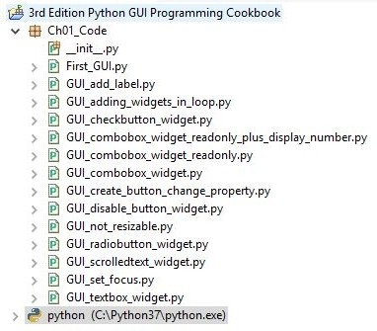
Creating the GUI Form and Adding Widgets Chapter 1
Here is an overview of the Python modules (ending in a .py extension) for this chapter:

Slide 4
Creating the GUI Form and Adding Widgets
Chapter 1
Creating our first Python GUI
Getting ready
To follow this recipe, a working Python development environment is a prerequisite. The IDLE GUI, which ships with Python, is enough to start. IDLE was built using tkinter!
How to do it…
Let's take a look at how to create our first Python GUI:
Create a new Python module and name it First_GUI.py.
At the top of the First_GUI.py module, import tkinter:
import tkinter as tk

Slide 5
Creating the GUI Form and Adding Widgets
Chapter 1
Create an instance of the Tk class:
win = tk.Tk()
Use the instance variable to set a title:
win.title("Python GUI")
Start the window's main event loop:
win.mainloop()

Slide 6
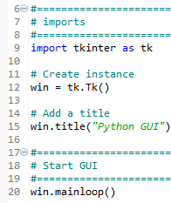

Creating the GUI Form and Adding Widgets
Chapter 1
The following screenshot shows the four lines of First_GUI.py required to create the resulting GUI:
6. Run the GUI module. On executing the preceding code, the following output is obtained:

Slide 7
Creating the GUI Form and Adding Widgets
Chapter 1
Preventing the GUI from being resized
By default, a GUI created using tkinter can be resized. This is not always ideal. The widgets we place onto our GUI forms might end up being resized in an improper way, so in this recipe, we will learn how to prevent our GUI from being resized by the user of our GUI application.

Slide 8
Creating the GUI Form and Adding Widgets Chapter 1
Start with the module from the previous recipe and save it as
Gui_not_resizable.py.
Use the Tk instance variable, win, to call the resizable method:
win.resizable(False, False)

Slide 9
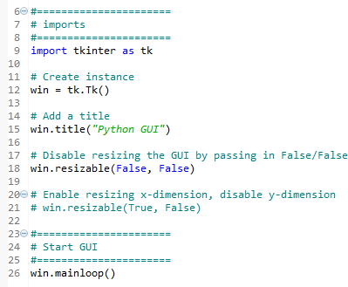
Creating the GUI Form and Adding Widgets Chapter 1
Here is the code to prevent the GUI from being resized (GUI_not_resizable.py):

Slide 10
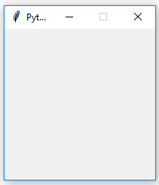
Creating the GUI Form and Adding Widgets
Chapter 1
3. Run the code. Running the code creates this GUI:

Slide 11
Creating the GUI Form and Adding Widgets Chapter 1
Adding a label to the GUI form
Getting ready
We are extending the first recipe, Creating our first Python GUI. We will leave the GUI resizable, so don't use the code from the second recipe (or comment the win.resizable line out).

Slide 12
Creating the GUI Form and Adding Widgets Chapter 1
Adding a label to the GUI form
How to do it…
Perform the following steps to add a label to the GUI from:
Start with the First_GUI.py module and save it as GUI_add_label.py.
Import ttk:
from tkinter import ttk
Use ttk to add a label:
ttk.Label(win, text="A Label")

Slide 13
Creating the GUI Form and Adding Widgets Chapter 1
Adding a label to the GUI form
How to do it…
Perform the following steps to add a label to the GUI from:
Use the grid layout manager to position the label:
.grid(column=0, row=0)
In order to add a Label widget to our GUI, we will import the ttk module from tkinter.
Please note the two import statements on lines 9 and 10.

Slide 14
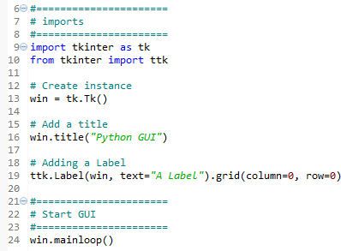
Creating the GUI Form and Adding Widgets Chapter 1
The following code is added just above win.mainloop(), which is located at the bottom of the first and second recipes (GUI_add_label.py):

Slide 15

Creating the GUI Form and Adding Widgets Chapter 1
5. Run the code and observe how a label is added to our GUI:

Slide 16
Creating the GUI Form and Adding Widgets Chapter 1
Creating buttons and changing their text attributes
In this recipe, we will add a button widget, and we will use this button to change an attribute of another widget that is a part of our GUI. This introduces us to callback functions and event handling in a Python GUI environment.

Slide 17
How to do it…
Creating the GUI Form and Adding Widgets Chapter 1
In this recipe, we will update the label we added in the previous recipe as well as the text attribute of the button. The steps to add a button that performs an action when clicked are as follows:
Start with the GUI_add_label.py module and save it as
GUI_create_button_change_property.py.
Define a function and name it click_me():
def click_me()

Slide 18
How to do it…
Creating the GUI Form and Adding Widgets Chapter 1
Use ttk to create a button and give it a text attribute:
action.configure(text="** I have been Clicked! **")
a_label.configure (foreground='red') a_label.configure(text='A Red Label')

Slide 19
How to do it…
Creating the GUI Form and Adding Widgets Chapter 1
Bind the function to the button:
action = ttk.Button(win, text="Click Me!", command=click_me)
Use the grid layout to position the button:
action.grid(column=1, row=0)

Slide 20
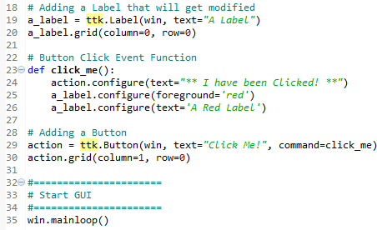
How to do it…
Creating the GUI Form and Adding Widgets Chapter 1
The preceding instructions produce the following code (GUI_create_button_change_property.py):

Slide 21


Creating the GUI Form and Adding Widgets
Chapter 1
6. Run the code and observe the output.
The following screenshot shows how our GUI looks before clicking the button:
After clicking the button, the color of the label changed and so did the text of the button, which can be seen in the following screenshot:

Slide 22
Creating the GUI Form and Adding Widgets Chapter 1
Creating textbox widgets
In tkinter, a typical one-line textbox widget is called Entry. In this recipe, we will add such an Entry widget to our GUI. We will make our label more useful by describing what the Entry widget is doing for the user.

Slide 23
Creating the GUI Form and Adding Widgets Chapter 1
Creating textbox widgets
How to do it…
Follow these steps to create textbox widgets:
Start with the GUI_create_button_change_property.py module and save it as GUI_textbox_widget.py.
Use the tk alias of tkinter to create a StringVar variable:
name = tk.StringVar()

Slide 24
Creating the GUI Form and Adding Widgets Chapter 1
Creating textbox widgets
How to do it…
Follow these steps to create textbox widgets:
Create a ttk.Entry widget and assign it to another variable:
name_entered = ttk.Entry(win, width=12, textvariable=name)
Use this variable to position the Entry widget:
name_entered.grid(column=0, row=1)

Slide 25
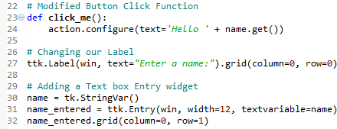
Creating the GUI Form and Adding Widgets
Chapter 1
The preceding instructions produce the following code (GUI_textbox_widget.py):

Slide 26


Creating the GUI Form and Adding Widgets
Chapter 1
5. Run the code and observe the output; our GUI looks like this:
6. Enter some text and click the button; we will see that there is a change in the GUI, which is as follows:

Slide 27
Creating the GUI Form and Adding Widgets Chapter 1
Setting the focus to a widget and disabling widgets
While our GUI is nicely improving, it would be more convenient and useful to have the cursor appear in the Entry widget as soon as the GUI appears.
In this recipe, we learn how to make the cursor appear in the Entry box for immediate text Entry rather than the need for the user to click into the Entry widget to give it the focus method before typing into the entry widget.

Slide 28
Creating the GUI Form and Adding Widgets Chapter 1
Setting the focus to a widget and disabling widgets
Getting ready
This recipe extends the previous recipe, Creating textbox widgets. Python is truly great. All we have to do to set the focus to a specific control when the GUI appears is call the focus() method on an instance of a tkinter widget we previously created. In our current GUI example, we assigned the ttk.Entry class instance to a variable named name_entered.
Now, we can give it the focus.

Slide 29
Creating the GUI Form and Adding Widgets Chapter 1
How to do it…
Place the following code just above the previous code, which is located at the bottom of the module, and which starts the main window's event loop, like we did in the previous recipes:
Start with the GUI_textbox_widget.py module and save it as
GUI_set_focus.py.
Use the name_entered variable we assigned the ttk Entry widget instance to and call the focus() method on this variable:
name_entered.focus()

Slide 30
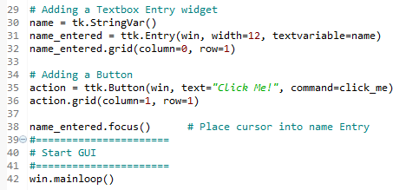
Creating the GUI Form and Adding Widgets Chapter 1
The preceding instructions produce the following code (GUI_set_focus.py):

Slide 31

Creating the GUI Form and Adding Widgets Chapter 1
3. Run the code and observe the output.

Slide 32
Creating the GUI Form and Adding Widgets Chapter 1
To disable widgets, we will set an attribute on the widget. We can make the button disabled by adding the following code below line 37 of the Python code to create the button:
Use the GUI_set_focus.py module and save it as
GUI_disable_button_widget.py.
Use the action button variable to call the configure method and set the state
attribute to disabled:
action.configure(state='disabled')
Call the focus() method on the name_entered variable:
name_entered.focus()

Slide 33


Creating the GUI Form and Adding Widgets Chapter 1
The preceding instructions produce the following code (GUI_disable_button_widget.py):
4. Run the code. After adding the preceding line of Python code, clicking the button no longer creates an action:

Slide 34
Creating the GUI Form and Adding Widgets Chapter 1
Creating combobox widgets
In this recipe, we will improve our GUI by adding drop-down comboboxes that can have initial default values. While we can restrict the user to only certain choices, we can also allow the user to type in whatever they wish.
Getting ready
This recipe extends the previous recipe, Setting the focus to a widget and disabling widgets.

Slide 35
Creating the GUI Form and Adding Widgets Chapter 1
Creating combobox widgets
How to do it…
We insert another column between the Entry widget and the Button widget using the grid layout manager. Here is the Python code:
Start with the GUI_set_focus.py module and save it as GUI_combobox_widget.py.
Change the button column to 2:
action = ttk.Button(win, text="Click Me!", command=click_me) action.grid(column=2, row=1)

Slide 36
Creating the GUI Form and Adding Widgets Chapter 1
Creating combobox widgets
How to do it…
We insert another column between the Entry widget and the Button widget using the grid layout manager. Here is the Python code:
Create a new ttk.Label widget:
ttk.Label(win, text="Choose a
number:").grid(column=1, row=0)

Slide 37
Creating the GUI Form and Adding Widgets
Chapter 1
Create a new ttk.Combobox widget:
number_chosen = ttk.Combobox(win, width=12, textvariable=number)
Assign values to the Combobox widget:
number_chosen['value'] = (1, 2, 4, 42, 100)
Place the Combobox widget into column 1:
number_chosen.grid(colum=1,row=1)
number_chosen.current(0)

Slide 38
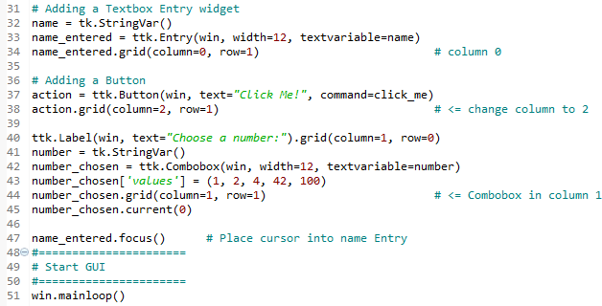
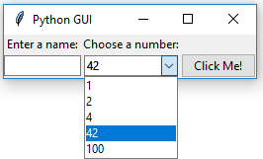
Creating the GUI Form and Adding Widgets
Chapter 1
7. Run the code.

Slide 39
Creating the GUI Form and Adding Widgets Chapter 1
If we want to restrict the user to only being able to select the values we have programmed into the Combobox widget, we can do it by passing the state attribute into the constructor. Modify line 42 as follows:
Start with the GUI_combobox_widget.py module and save it as
GUI_combobox_widget_readonly.py.
Set the state attribute when creating the Combobox widget:
number_chosen = ttk.Combobox(win, width=12, textvariable=number, state='readonly')

Slide 40

Creating the GUI Form and Adding Widgets Chapter 1
The preceding steps produce the following code (GUI_combobox_widget_readonly.py:

Slide 41
Creating the GUI Form and Adding Widgets Chapter 1
3. Run the code.
Now, users can no longer type values into the Combobox widget.
We can display the value chosen by the user by adding the following line of code to our button click event callback function:
Start with the GUI_combobox_widget_readonly.py module and save it as
GUI_combobox_widget_readonly_plus_display_number.py.
Extend the button click event handler by using the get() method on the name variable, use concatenation (+ ' ' +), and also get the number from the number_chosen variable (also calling the get() method on it):
def click_me():
action.configure(text='Hello ' + name.get() + ' ' + number_chosen.get())

Slide 42

Creating the GUI Form and Adding Widgets Chapter 1
3. Run the code.
After choosing a number, entering a name, and then clicking the button, we get the following GUI result, which now also displays the number selected next to the name entered (GUI_combobox_widget_readonly_plus_display_number.py:

Slide 43
Creating the GUI Form and Adding Widgets Chapter 1
Creating a check button with different initial states
In this recipe, we will add three check button widgets, each with a different initial state:
The first is disabled and has a checkmark in it. The user cannot remove this checkmark as the widget is disabled.
The second check button is enabled, and by default has no checkmark in it, but the user can click it to add a checkmark.
The third check button is both enabled and checked by default. The users can uncheck and recheck the widget as often as they like
Getting ready
This recipe extends the previous recipe, Creating combobox widgets.

Slide 44
Creating the GUI Form and Adding Widgets
Chapter 1
How to do it…
Here is the code for creating three check button widgets that differ in their states:
Start with the GUI_combobox_widget_readonly_plus_display_number.py module and save it as GUI_checkbutton_widget.py.
Create three tk.IntVar instances and save them in local variables:
chVarDis = tk.IntVar() chVarUn = tk.IntVar() chVarEn = tk.IntVar()

Slide 45
Creating the GUI Form and Adding Widgets
Chapter 1
How to do it…
Here is the code for creating three check button widgets that differ in their states:
Set the text attributes for each of the Combobox widgets we are creating:
text="Disabled" text="UnChecked" text="Enabled"
Set their state to deselect/select:
check1.select() check2.deselect() check3.select()

Slide 46
Creating the GUI Form and Adding Widgets
Chapter 1
How to do it…
Here is the code for creating three check button widgets that differ in their states:
Use grid to lay them out:
check1.grid(column=0, row=4, sticky=tk.W)
check2.grid(column=1, row=4, sticky=tk.W)
check3.grid(column=2, row=4, sticky=tk.W)

Slide 47
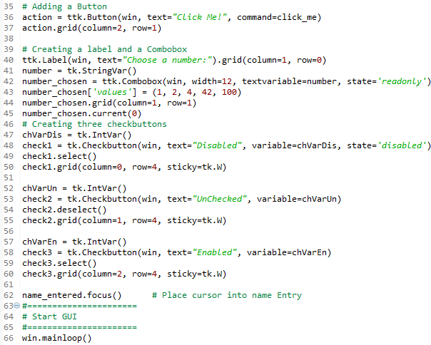
Creating the GUI Form and Adding Widgets
Chapter 1
The preceding steps will finally produce the following code (GUI_checkbutton_widget.py):

Slide 48
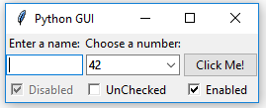
Creating the GUI Form and Adding Widgets
Chapter 1
6. Run the module. Running the new code results in the following GUI:

Slide 49
Creating the GUI Form and Adding Widgets Chapter 1
Using radio button widgets
In this recipe, we will create three radio button widgets. We will also add some code that changes the color of the main form, depending upon which radio button is selected.
Getting ready
This recipe extends the previous recipe, Creating a check button with different initial states.

Slide 50
Creating the GUI Form and Adding Widgets Chapter 1
How to do it…
We add the following code to the previous recipe:
Start with the GUI_checkbutton_widget.py module and save it as
GUI_radiobutton_widget.py.
Create three module-level global variables for the color names:
COLOR1 = "Blue"
COLOR2 = "Gold"
COLOR3 = "Red"

Slide 51
Creating the GUI Form and Adding Widgets Chapter 1
How to do it…
We add the following code to the previous recipe:
Create a callback function for the radio buttons:
if radSel == 1:
win.configure(background=COLOR1)
elif radSel == 2:
win.configure(background=COLOR2)
elif radSel == 3:
win.configure(background=COLOR3)

Slide 52
Creating the GUI Form and Adding Widgets Chapter 1
How to do it…
We add the following code to the previous recipe:
Create three tk radio buttons:
rad1 = tk.Radiobutton(win, text=COLOR1, variable=radVar, value=1, command=radCall)
rad2 = tk.Radiobutton(win, text=COLOR2, variable=radVar, value=2, command=radCall)
rad3 = tk.Radiobutton(win, text=COLOR3, variable=radVar, value=3, command=radCall)

Slide 53
Creating the GUI Form and Adding Widgets Chapter 1
How to do it…
Use the grid layout to position them:
rad1.grid(column=0, row=5, sticky=tk.W, columnspan=3)
rad2.grid(column=1, row=5, sticky=tk.W, columnspan=3)
rad3.grid(column=2, row=5, sticky=tk.W, columnspan=3)

Slide 54
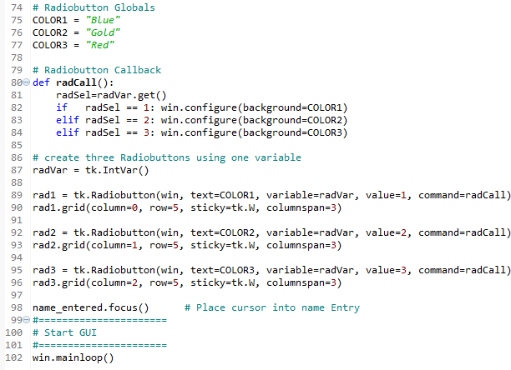
Creating the GUI Form and Adding Widgets
Chapter 1
The preceding steps will finally produce the following code (GUI_radiobutton_widget.py):

Slide 55
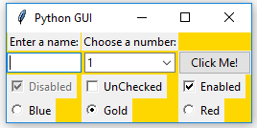
Creating the GUI Form and Adding Widgets
Chapter 1
6. Run the code. Running this code and selecting the radio button named Gold
creates the following window:

Slide 56
Creating the GUI Form and Adding Widgets Chapter 1
There's more…
Here is a small sample of the available symbolic color names that you can look up in the official TCL documentation at http://www.tcl.tk/man/tcl8.5/TkCmd/colors.htm:
Name | Red | Green | Blue
alice blue | 240 | 248 | 255
AliceBlue | 240 | 248 | 255
Blue | 0 | 0 | 255
Gold | 255 | 215 | 0
Red | 255 | 0 | 0
Some of the names create the same color, so alice blue creates the same color as AliceBlue. In this recipe, we used the symbolic names Blue, Gold, and Red.

Slide 57
Creating the GUI Form and Adding Widgets Chapter 1
:
Using scrolled text widgets
ScrolledText widgets are much larger than simple Entry widgets and span multiple lines. They are widgets like Notepad and wrap lines, automatically enabling vertical scroll bars when the text gets larger than the height of the ScrolledText widget.

Slide 58
Creating the GUI Form and Adding Widgets Chapter 1
:
How to do it…
By adding the following lines of code, we create a ScrolledText widget:
1. Start with the GUI_radiobutton_widget.py module and save it as
GUI_scrolledtext_widget.py.
Import scrolledtext:
from tkinter import scrolledtext
Define variables for the width and height:
scrol_w = 30
scrol_h = 3

Slide 59
Creating the GUI Form and Adding Widgets Chapter 1
:
How to do it…
By adding the following lines of code, we create a ScrolledText widget:
Create a ScrolledText widget:
scr = scrolledtext.ScrolledText(win, width=scrol_w, height=scrol_h, wrap=tk.WORD)
Position the widget:
scr.grid(column=0, columnspan=3)

Slide 60
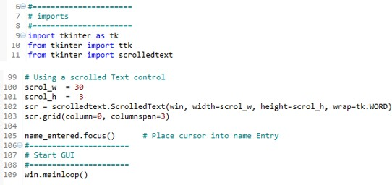
Creating the GUI Form and Adding Widgets Chapter 1
:
How to do it…
By adding the following lines of code, we create a ScrolledText widget:
The preceding steps will finally produce the following code (GUI_scrolledtext_widget.py):

Slide 61
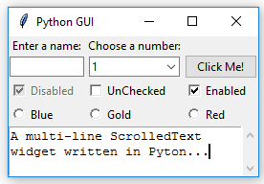
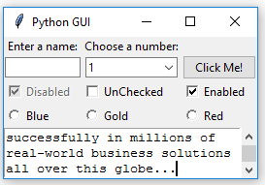
Creating the GUI Form and Adding Widgets
Chapter 1
6. Run the code. We can actually type into our widget, and if we type enough words, the lines will automatically wraparound:
Once we type in more words than the height of the widget can display, the vertical scroll bar becomes enabled. This all works out of the box without us needing to write any more code to achieve this:

Slide 62
Creating the GUI Form and Adding Widgets Chapter 1
Adding several widgets in a loop
So far, we have created several widgets of the same type (for example, a radio button) by basically copying and pasting the same code and then modifying the variations (for example, the column number). In this recipe, we start refactoring our code to make it less redundant.
Getting ready
We are refactoring some parts of the previous recipe's code, Using scrolled text widgets, so you need that code for this recipe.

Slide 63
Creating the GUI Form and Adding Widgets Chapter 1
Adding several widgets in a loop
How to do it…
Here's how we refactor our code:
Start with the GUI_scrolledtext_widget.py module and save it as
GUI_adding_widgets_in_loop.py.
Delete the global name variables and create a Python list instead:
colors = ["Blue", "Gold", "Red"]

Slide 64
Creating the GUI Form and Adding Widgets
Chapter 1
Use the get() function on the radio button variable:
radSel=radVar.get()
Create logic with an if ... elif structure:
if radSel == 0:
win.configure(background=colors[0])
elif radSel == 1:
win.configure(background=color[1])
elif radSel == 2:
win.configure(background=color[2])

Slide 65
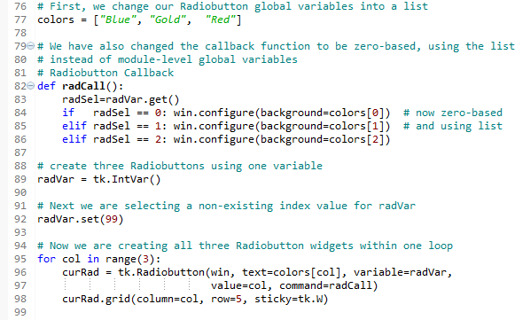
Creating the GUI Form and Adding Widgets
Chapter 1
Use a loop to create and position the radio buttons:
for col in range(3):
curRad = tk.Radiobutton(win, text=colors[col], cariable=radVar, value, command=radCall)
curRad.brid(column=col, row=5, sticky=tk.W)
Run the code (GUI_adding_widgets_in_loop.py):
Running this code will create the same window as before, but our code is much cleaner and easier to maintain. This will help us when we expand our GUI in the coming recipes.

